Slide 1
Applied Physics NS (101)
LECTURE # 5
DATE: 27TH AUGUST , 2019

Slide 2
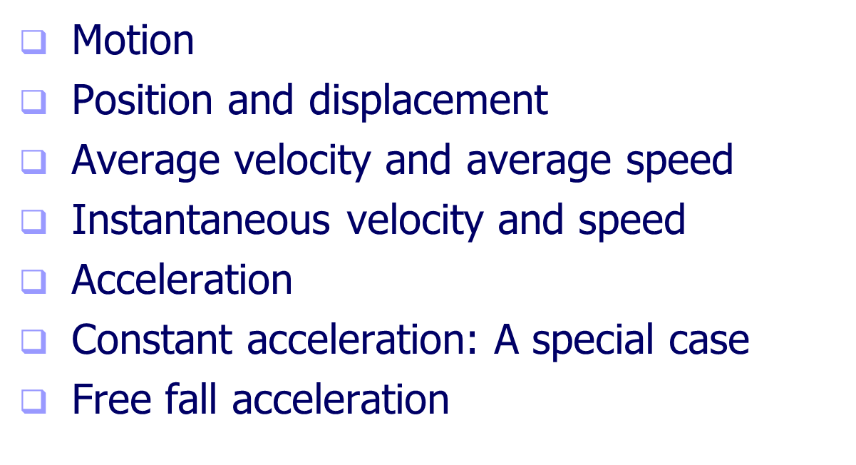
Linear Motion

Slide 3

Motion
Motion – an object’s change in position relative to a reference point

Slide 4




Reference Point
The Earth’s surface is used as a common reference point
A moving object can be used as a reference point as well

Slide 5
Kinematics – describing motion
Object is treated as a particle (a point-like concentration of matter that has no size, no shape and no internal structure).
Questions to ask:
Where is the particle?
How fast is it moving?
How rapidly is it speeding up or slowing down?

Slide 6
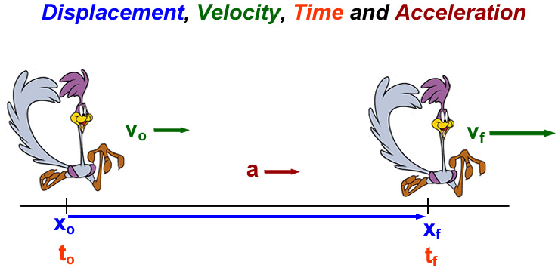
Basic Quantities in Kinematics

Slide 7
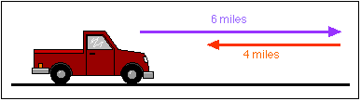
Distance
Farmer Jones drives 6 miles down a straight road. She turns around and drives 4 miles back. What was her average speed for this trip if it took 1 hour?

Slide 8
Your answer to this problem depends on your interpretation of "distance traveled". You could say:
The total distance traveled by Farmer Jones is 10 miles. Therefore her average speed is 10 mi/hr.
The net distance traveled by Farmer Jones is 2 miles. Therefore, her average speed is 2 mi/hr.
There are good reasons to use either interpretation - it's mostly a matter of preference. We will interpret "distance traveled" to be net distance (also called displacement). Farmer Jones' average speed was 2 mi/hr.

Slide 9

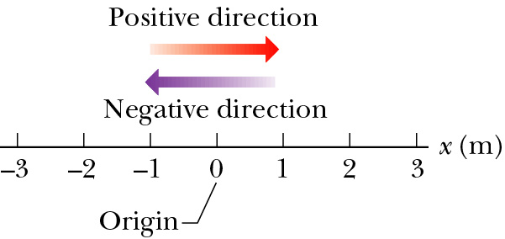
Displacement
Displacement is a change of position in time.
Displacement:
  f stands for final and i stands for initial.
It is a vector quantity.
It has both magnitude and direction: + or − sign
It has units of [length]: meters.
x₁ (t₁) = + 2.5 m
x₂ (t₂) = - 2.0 m
Δx = -2.0 m - 2.5 m = -4.5 m
x₁ (t₁) = - 3.0 m
x₂ (t₂) = + 1.0 m
Δx = +1.0 m + 3.0 m = +4.0 m

Slide 10
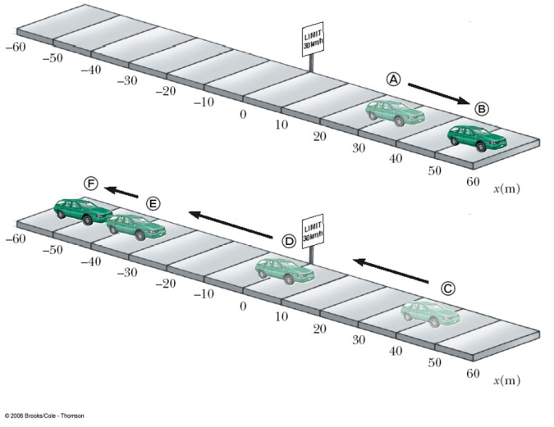
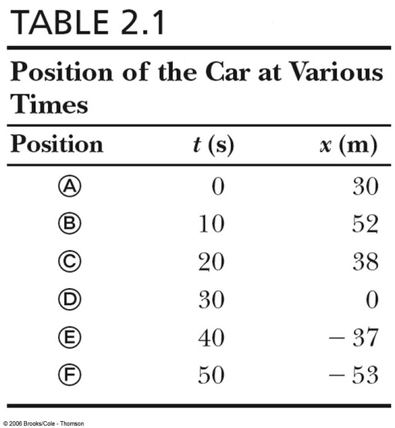
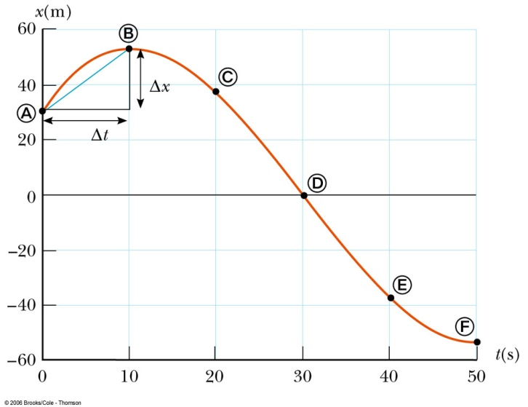
Distance and Position-time graph
Displacement in space
  From A to B: Δx = x_{B} – x_{A} = 52 m – 30 m = 22 m
  From A to C: Δx = x_{c} – x_{A} = 38 m – 30 m = 8 m
Distance is the length of a path followed by a particle
  from A to B: d = |x_{B} – x_{A}| = |52 m – 30 m| = 22 m
  from A to C: d = |x_{B} – x_{A}|+ |x_{C} – x_{B}| = 22 m + |38 m – 52 m| = 36 m
Displacement is not Distance.
Jan. 28-Feb. 1, 2013

Slide 11
Speed
Speed is a scalar quantity which refers to "how fast an object is moving.“
  Speed can be thought of as the rate at which an object covers distance, or distance per time.
  A fast-moving object has a high speed; a slow-moving object has a low speed.
  An object with no movement at all has a zero speed.
Normally, objects do not travel at a constant speed
Average Speed = total distance
total time

Slide 12


Instantaneous Speed
and Average Speed
Instantaneous speed is the speed at any given instant in time.
  What the speedometer reads when you look at it
Average speed is the average of all instantaneous speeds
  The average of an infinite number of speedometer readings during a trip
  Found simply by a total distance/total time ratio

Slide 13
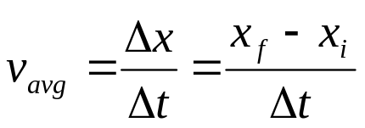
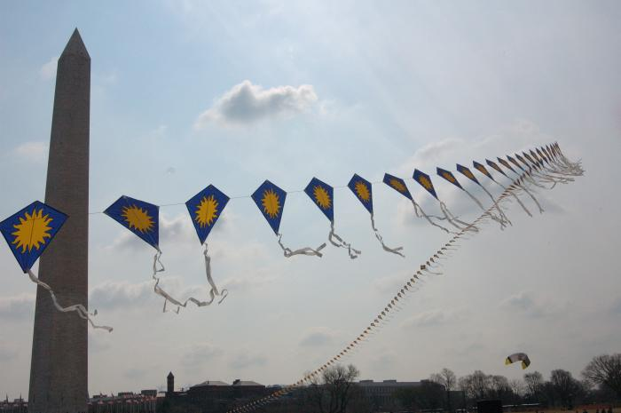
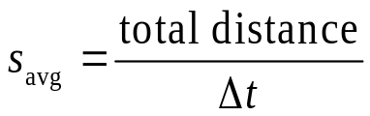
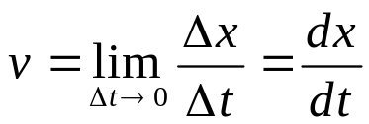
Velocity
Velocity is the rate of change of position.
Velocity is a vector quantity.
Velocity has both magnitude and direction.
Velocity has a unit of [length/time]: meter/second.
We will be concerned with three quantities, defined as:
  Average velocity
  Average speed
  Instantaneous
  velocity
displacement
distance
displacement

Slide 14
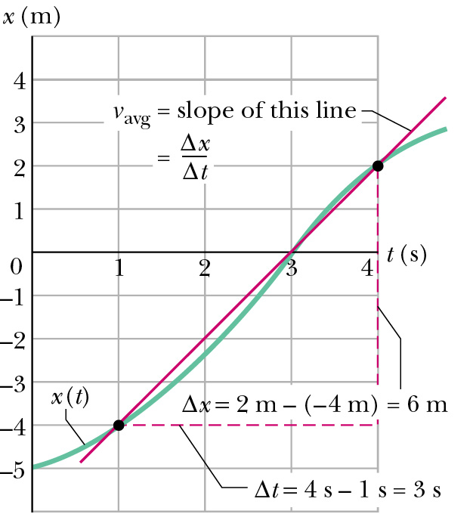
Average Velocity
Average velocity
is the slope of the line segment between end points on a graph.
Dimensions: length/time (L/T) [m/s].
SI unit: m/s.
It is a vector (i.e. is signed), and displacement direction sets its sign.

Slide 15
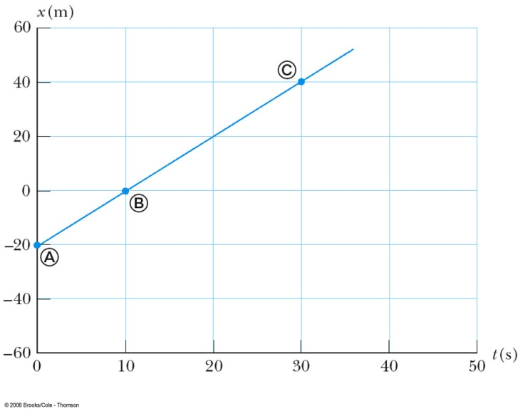
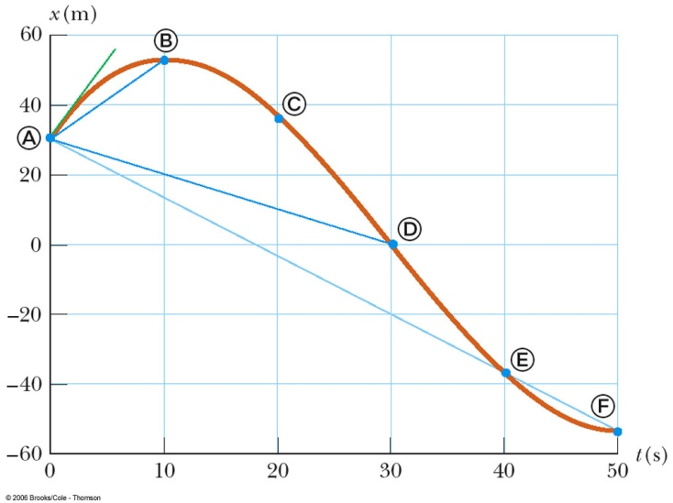
Graphical Interpretation of Velocity
Velocity can be determined from a position-time graph
Average velocity equals the slope of the line joining the initial and final positions. It is a vector quantity.
An object moving with a constant velocity will have a graph that is a straight line.

Slide 16
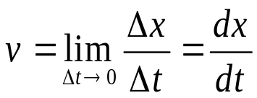
Instantaneous Velocity
Instantaneous means “at some given instant”. The instantaneous velocity indicates what is happening at every point of time.
Limiting process:
  Chords approach the tangent as Δt => 0
  Slope measure rate of change of position
Instantaneous velocity:
It is a vector quantity.
Dimension: length/time (L/T), [m/s].
It is the slope of the tangent line to x(t).
Instantaneous velocity v(t) is a function of time.

Slide 17
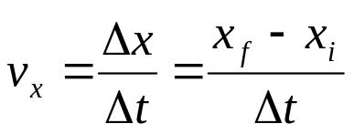

Uniform Velocity
Uniform velocity is the special case of constant velocity
In this case, instantaneous velocities are always the same, all the instantaneous velocities will also equal the average velocity
Begin with then
x
v
Note: we are plotting velocity vs. time
x(t)
v(t)
x_{f}
v_{x}
x_{i}
0
t
0
t
t_{i}
t_{f}
Jan. 28-Feb. 1, 2013

Slide 18
Earth’s motion around the Sun
r=1.5x10¹¹m
distance
elapsed time
2 π r
2 x 3.14 x 1.5 x 10¹¹m
365 days x 24 hr/day
V =
=
=
1year
9.4 x 10¹¹ m
8760 hr
9.4 x 10¹¹ m
8.76 x10³ hr
9.4
8.7
=
=
= x 10¹¹⁻³ m/hr
=10⁻³km
= 1.1x10⁵ km/hr
≈ 110,000 km/hr
= 1.1x10⁸ m/hr

Slide 19

Tip of a watch’s minute hand
r=1 cm
distance
elapsed time
2 π r
2 x 3.14 x 1cm
60 min x 60 s/min
V =
=
=
1hr
6.28 cm
3600 s
6.28 cm
3. 6 x10³s
=
=
= 1.7x10⁻³ cm/s
=10⁻²m
= 1.7x10⁻⁵ m/s

